Slide 1
Integrating Nuclear and Renewable Energy Sources
Adria Peterkin, Joseph Lee, Pedro Vicente

Slide 2
What is the Electricity Grid ?
Generation
Centralized- large production power plants such as coal, natural gas, and nuclear
Decentralized- located close to areas of consumption such as solar energy
Transmission and Distribution
The Electricity generated is transmitted through substations and powerlines
-Can travel long distances, can be located above or below ground
Consumption
Voltage is stepped down and delivered for consumption
-Varies depending on the customer, can be residential, industrial, or commercial
1
2
3

Slide 3
Primary Focus: Energy Production
Fossil Fuels
Renewable Energy
Non-Renewable Energy
Solar Energy
Wind Energy
Geothermal
Hydropower
Coal
Natural Gas
Crude Oil
Nuclear Energy
Fossil Fuels
Clean Energy
Nuclear Energy
Renewable Energy

Slide 4
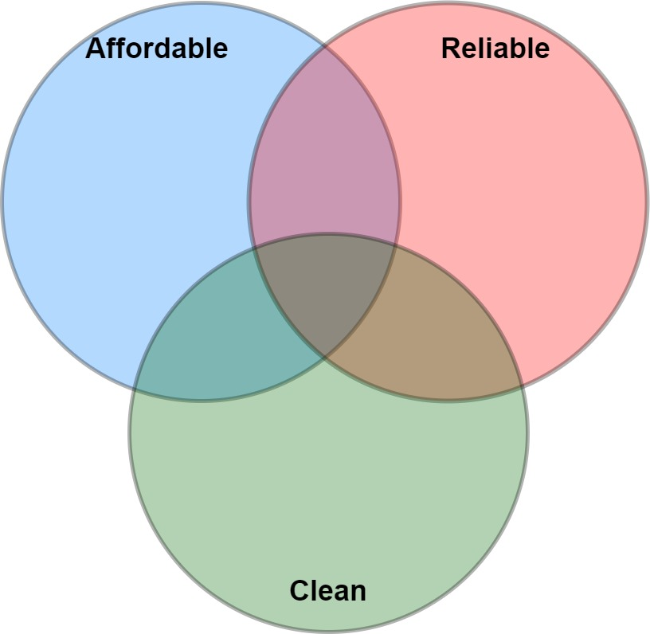




Requirements for an ideal energy production method
Low construction costs
Low licensing cost
Low operating costs
Fossil Fuels
Sufficient power output
Steady power output
Variable power output
Hydro
Nuclear
Wind
Solar
Minimal environmental impact
Minimal greenhouse gas (GHG) emission
Notes:
An ideal energy production method is affordable, reliable, and clean. Before we can analyze the different production methods, we must define what it means to have these qualities. An affordable energy production method has low construction, licensing, and operating costs because these costs get passed onto the customer. Obviously, in an economics driven world, regardless of how perfect an energy source is, if it’s too expensive, it won’t be sustainable.A reliable production method produces as much energy that the grid needs without many fluctuations. Additionally, it is important to be able to provide a variable power output so you don’t overproduce or underproduce power. Finally, a clean production method won’t affect the local environment or release an excess of greenhouse gases.
Here are where a few modern energy generation methods fall within this diagram but it is clear that there is no ideal energy production method at the moment.

Slide 5
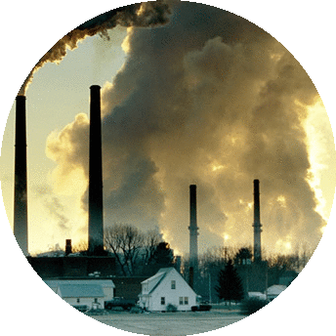
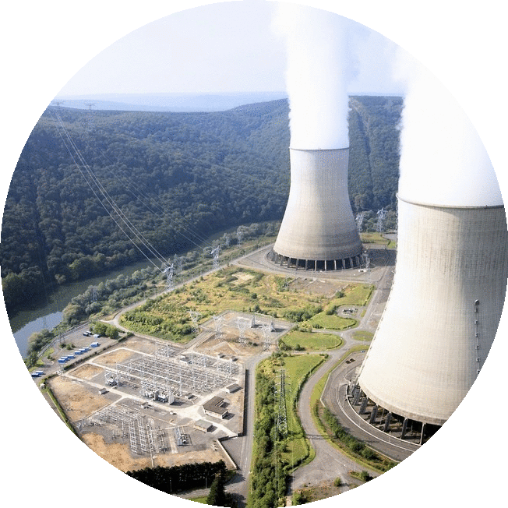
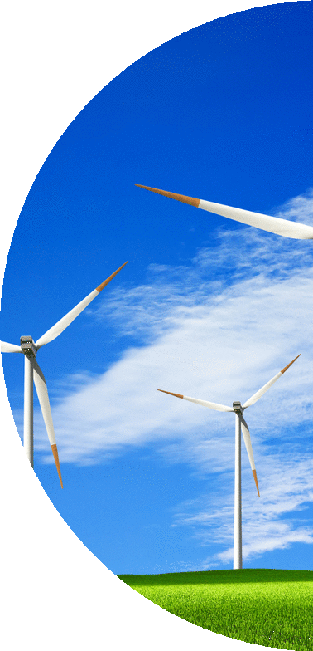
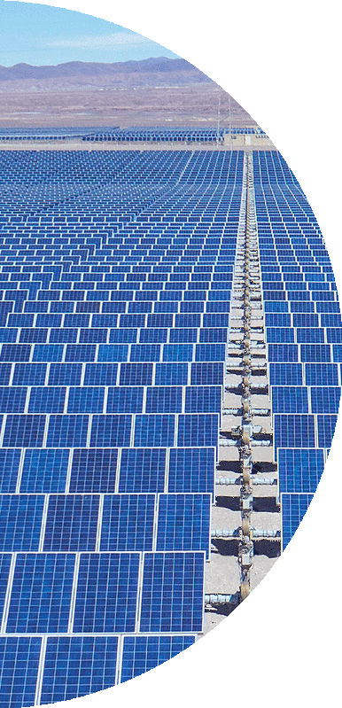

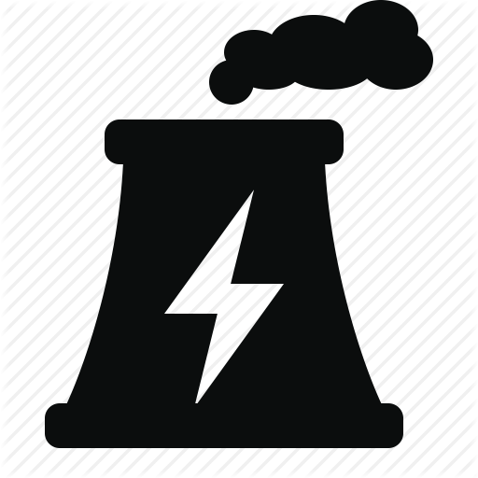

Benefits and shortcomings of power production
Fossil Fuels Nuclear
Renewables
Pros
Steady production
Load following
Cheap
Cons
GHG emissions
Environmental impact from fuel retrieval
Pros
Steady production
No GHG emission during operation
Cons
Expensive construction
Expensive licensing
No load following
Pros
No GHG
No fuel constraints
Low operational costs
Cons
Expensive
Irregular energy production
Uncontrollable output
Notes:
In the currently available solutions, the main contenders are fossil fuels, nuclear, and renewables.
About two thirds of our energy comes from fossil fuels. Fossil fuels are extremely cheap and produce a steady amount of energy that can be ramped up when needed. Obviously, the downsides of fossil fuels stem from its production of GHG and that fuel retrieval methods are usually detrimental to the environment they are taken from.
On a similar vein, nuclear energy produces a large amount steady amount of energy without producing GHG. On the flipside, they have high base prices due to the stringent regulations which is makes them unattractive to construct and they are unable to change their power output economically so they end up losing a lot of revenue at low demand hours.
Renewables produce clean energy and they have low operational costs because their fuel is technically infinite. The downsides are that it they are still expensive compared to other energy sources and that their production times and amount depend heavily on weather conditions. This negatively affects grid stability since the energy source isn’t reliable.

Slide 6
Benefits and shortcomings of power production
Fossil Fuels Nuclear
Renewables
Pros
Steady production
Load following
Cheap
Cons
GHG emissions
Environmental impact from fuel retrieval
Pros
Steady production
No GHG emission during operation
Cons
Expensive construction
Expensive licensing
No load following
Pros
No GHG
No fuel constraints
Low operational costs
Cons
Expensive
Irregular energy production
Uncontrollable output
Notes:
In the currently available solutions, the main contenders are fossil fuels, nuclear, and renewables.
About two thirds of our energy comes from fossil fuels. Fossil fuels are extremely cheap and produce a steady amount of energy that can be ramped up when needed. Obviously, the downsides of fossil fuels stem from its production of GHG and that fuel retrieval methods are usually detrimental to the environment they are taken from.
On a similar vein, nuclear energy produces a large amount steady amount of energy without producing GHG. On the flipside, they have high base prices due to the stringent regulations which is makes them unattractive to construct and they are unable to change their power output economically so they end up losing a lot of revenue at low demand hours.
Renewables produce clean energy and they have low operational costs because their fuel is technically infinite. The downsides are that it they are still expensive compared to other energy sources and that their production times and amount depend heavily on weather conditions. This negatively affects grid stability since the energy source isn’t reliable.

Slide 7
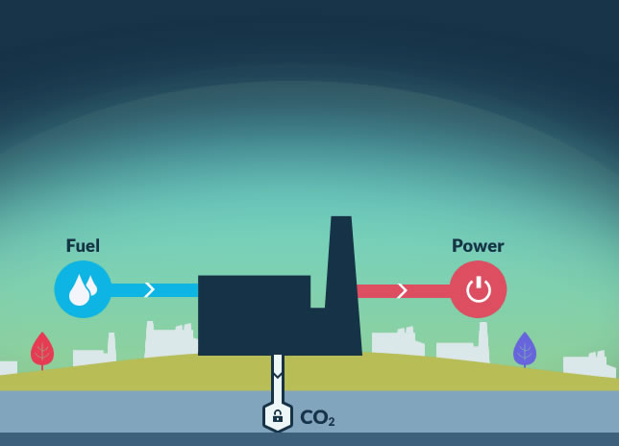
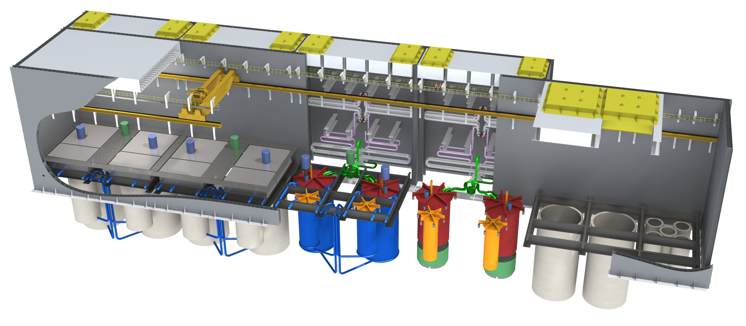
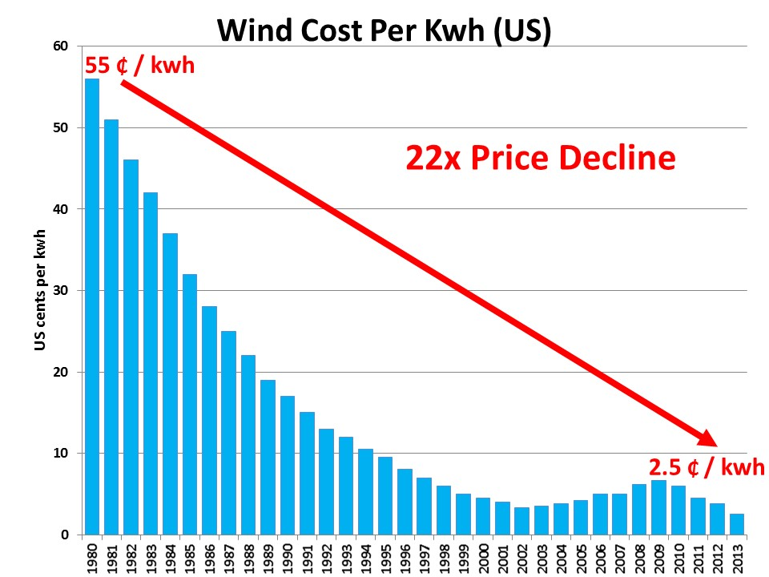
Strengthening current production methods
Fossil Fuels Nuclear Renewables
Carbon capture Design simplification Technological Improvements
Still GHG emission
No load following
Uncontrollable generation
Notes:
One solution to this issue would be to augment the current energy production methods. To reduce GHG emissions of fossil fuels, carbon capture can be implemented. Nuclear can be made cheaper with design simplification and more efficient with newer reactor models. Furthermore renewables have been getting cheaper over the years and there may come a day when it beats out other generation methods.
Yet even with all sorts of innovations, these energy generation methods alone still aren’t ideal. Fossil fuels still generate greenhouse gases, nuclear still can’t load follow, and renewables cannot produce energy at will. Thus a novel way of producing clean energy must be considered.

Slide 8
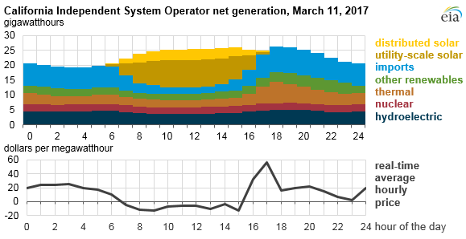
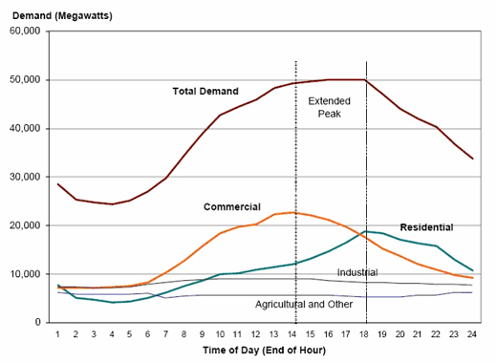
Nuclear Energy challenge: Load Following. Electricity demand in california varies greatly throughout the day and seasons.

Slide 9
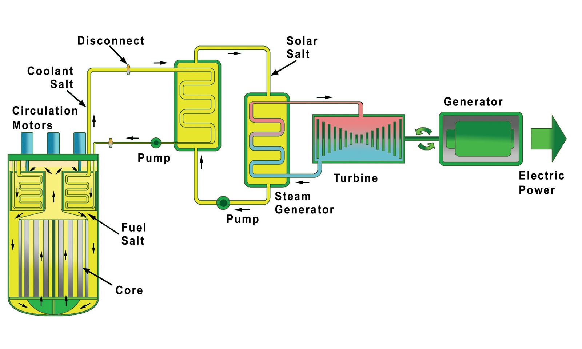
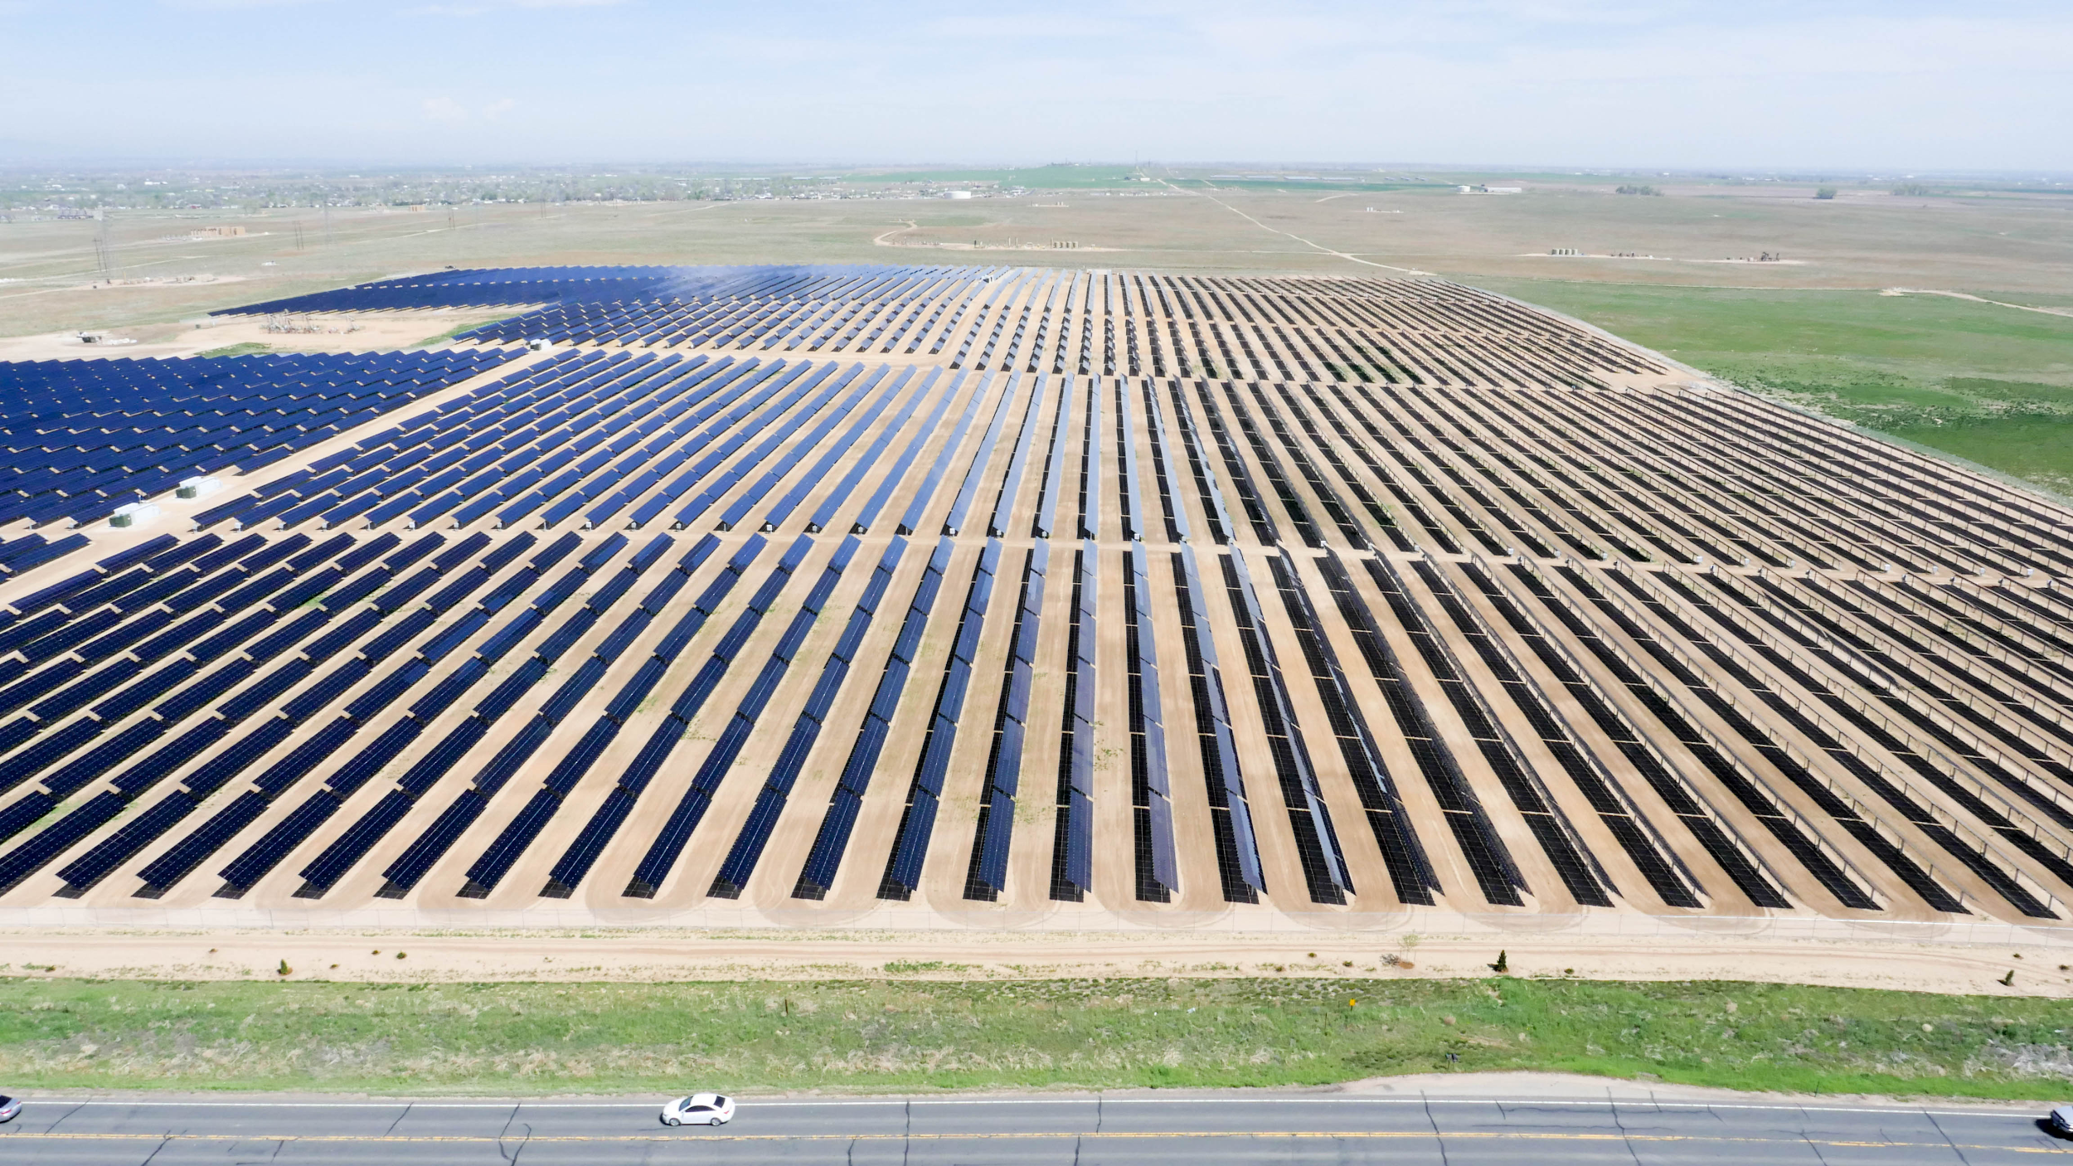
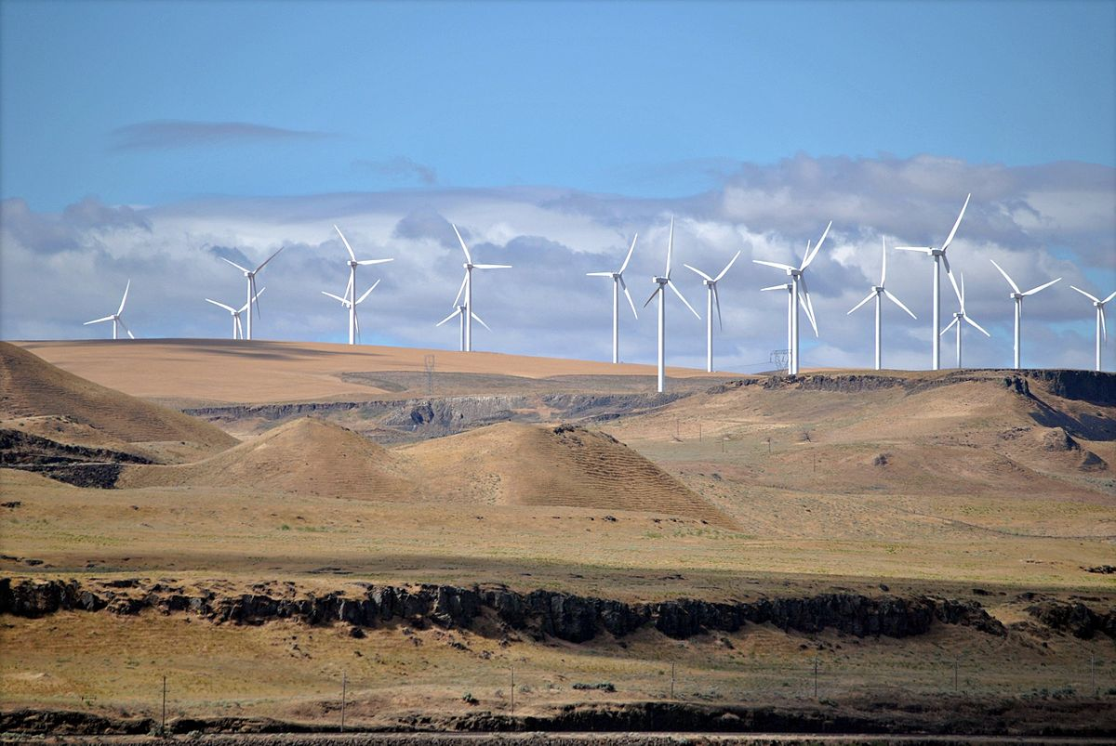
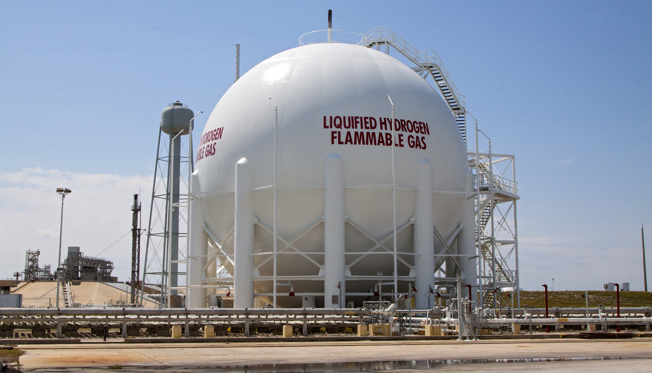

Slide 10
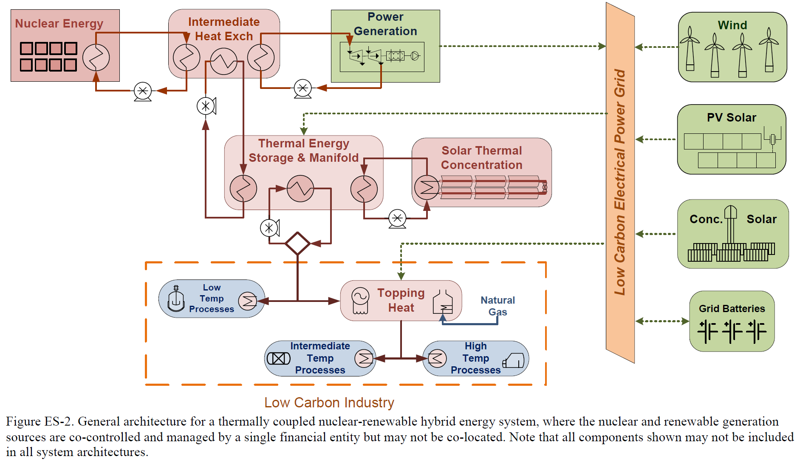
Nuclear-Renewable Integrated Systems are the solution to the challenges that nuclear and renewable energy sources face.

Slide 11
Questions?

